Slide 1
Segmentation Overview
Nick Trajkovski

Slide 2
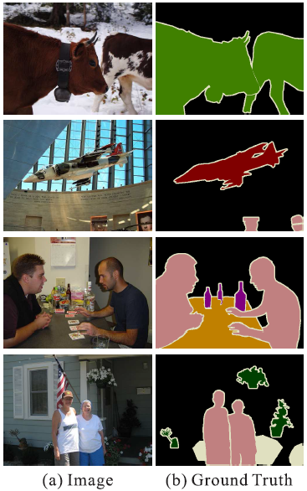
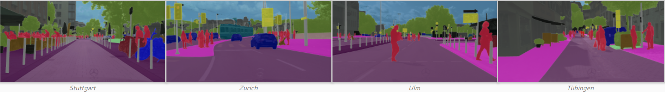
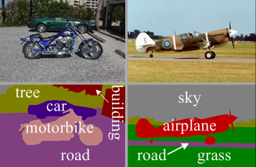
Segmentation benchmarking
Pascal VOC
City Scapes
MSRC-21

Slide 3
Segmentation Libraries
Comprehensive list: https://github.com/mrgloom/awesome-semantic-segmentation
PSPNet: Pascal rank: 6. Caffe, TensorFlow, Torch
Most contributions TensorFlow (5)
DUC, HDC: Pascal rank: 10. Torch
Implementation incomplete
SegNet: Pascal rank:12. TensorFlow, Torch, Caffe
Most contributors Caffe version (113). Supports Cudnn5. Uses modified Caffe.
Dilated convolution: Builds on top of DeepLab. Caffe
DeepLab: Pascal rank: 18. TensorFlow, Caffe
FCN: Pascal rank: 22. Caffe, Torch, TensorFlow
General Observation: Low contributors per repo
Notes:
Fully Convolutional Networks for Semantic Segmentation (FCN)

Slide 4
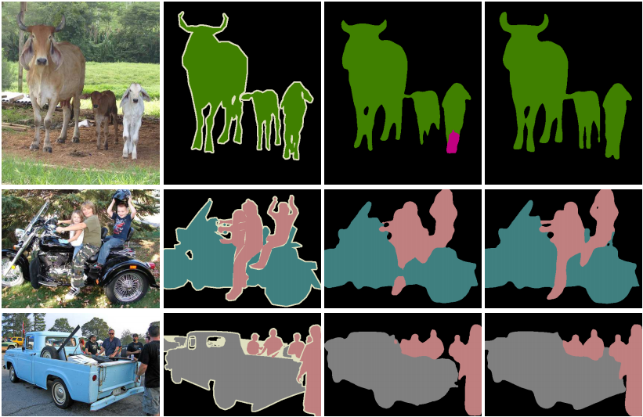
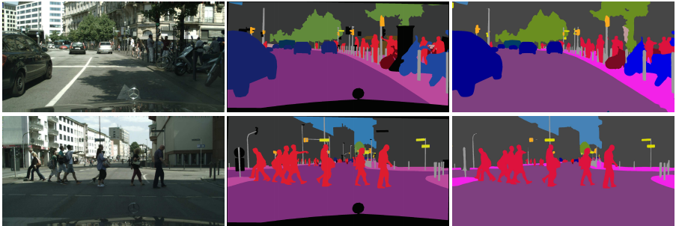
Segmentation Libraries
PSPNet
Image Ground Truth PSPNet
Image Ground Truth DeepLab PSPNet
Notes:
Fully Convolutional Networks for Semantic Segmentation (FCN)

Slide 5
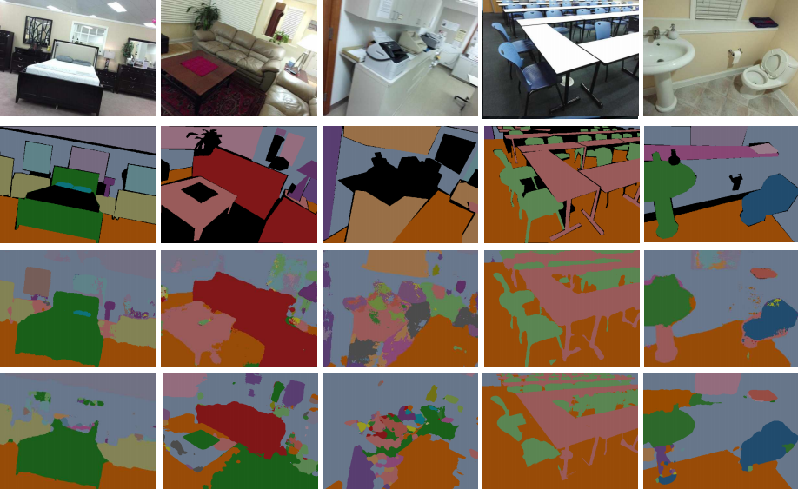
Segmentation Libraries
SegNet
Image
Ground Truth
SegNet
DeepLab
Notes:
Fully Convolutional Networks for Semantic Segmentation (FCN)

Slide 6
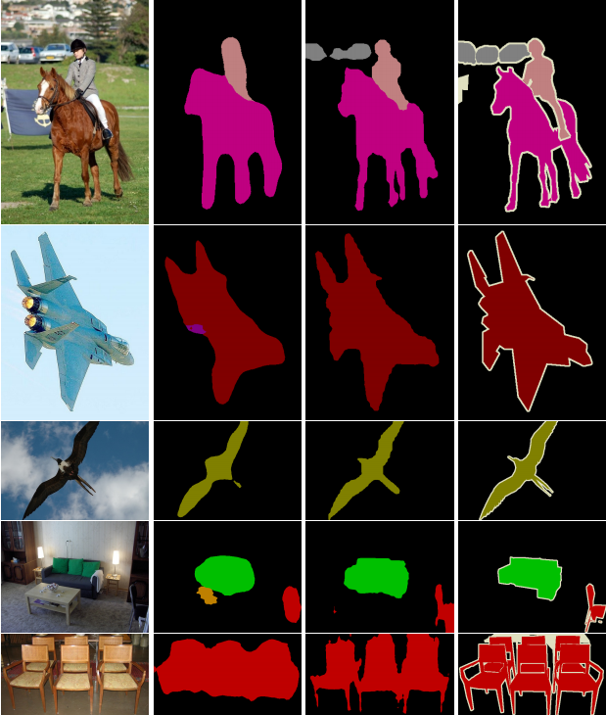
Segmentation Libraries
Dilated convolution
Image DeepLab DC Ground Truth
Notes:
Fully Convolutional Networks for Semantic Segmentation (FCN)

Slide 7
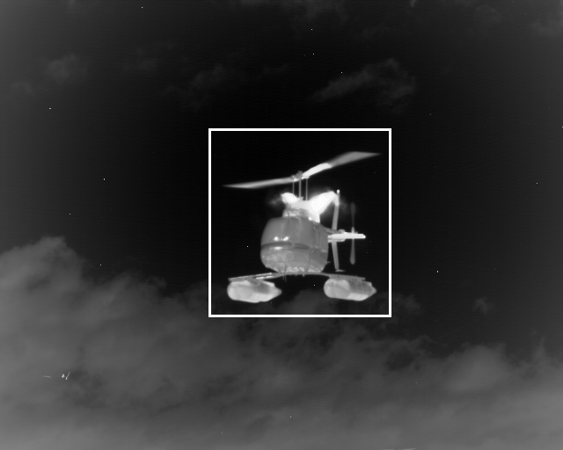
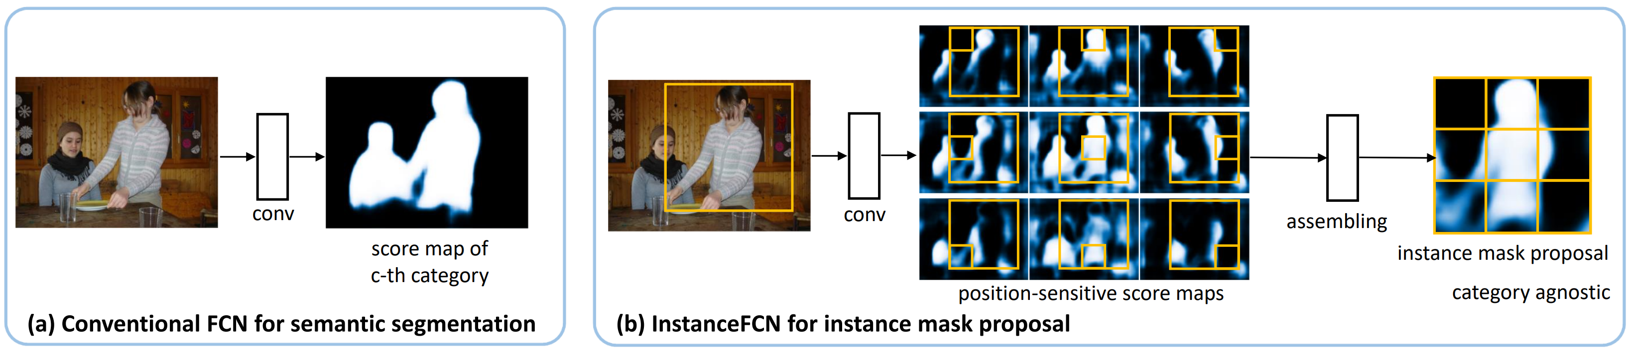
Instance Aware Segmentation
What is it?
Region-wise, translation variant.
Solves problem with conventional FCNs where convolution is translation invariant, the same image pixel receives the same responses (thus classification scores) irrespective to its relative position in the context.
operates on region level, and the same pixel can have different semantics in different regions.

Slide 8
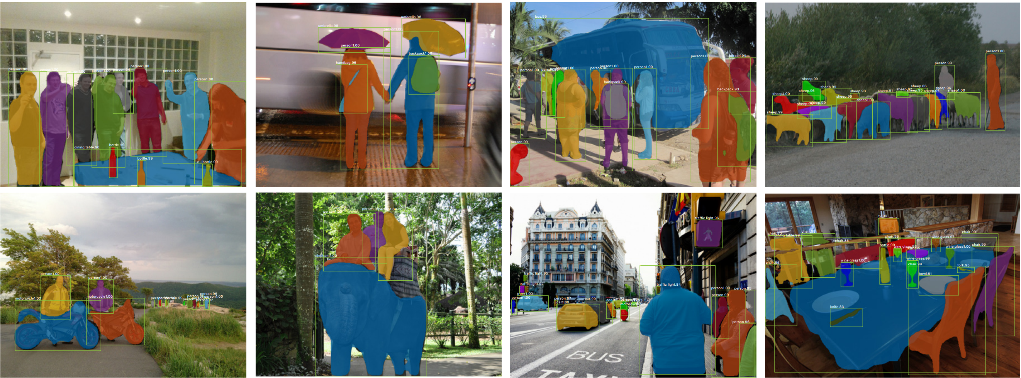
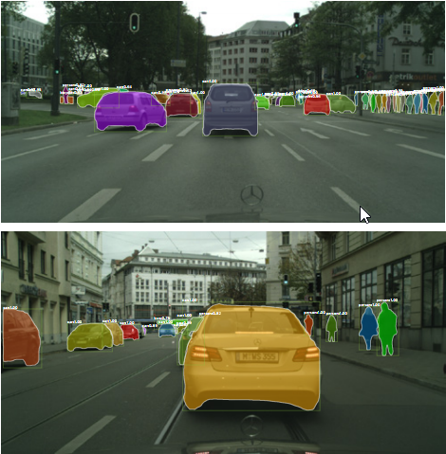
Instance Aware Segmentation Frameworks
Mask-RCNN – Facebook Research: Caffe, TensorFlow (9 contributors)

Slide 9
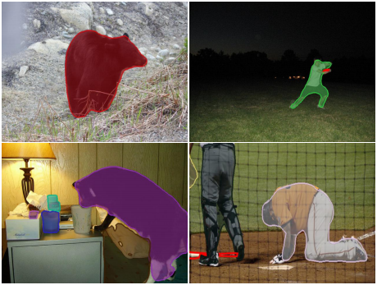
Instance Aware Segmentation Frameworks
SharpMask – Facebook Research: Torch

Slide 10
Next Steps
Test out the highest ranking Segmentation library
Test out an Instance Aware Segmentation library
Compare results to current results
Test for short wave

